Slide 1






Best Practices and Architecture
Useful Patterns and Code Structure
Best
Practices
SoftUni Team
Technical Trainers
Software University
http://softuni.bg

Slide 2

Table of Contents
Project Structure
EF Core Optimizations
Useful Patterns

Slide 3
Questions
sli.do #CSharpDB

Slide 4
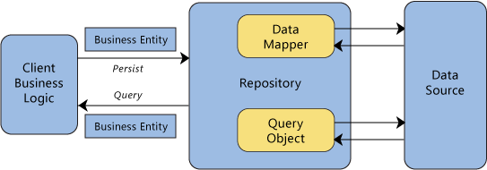
Project Structure
Organizing Large Solutions

Slide 5
Importance of Organized Code
Scalability
Maintainability
Manageability
Testability
S
Single Responsibility
O
Open / Closed
L
Liskov Substitution
I
Interface Segregation
D
Dependency Inversion

Slide 6
Project Organization
Application code can be split into sections:
Data Layer – database connection (context)
Domain Models – entity classes
Client – user-interaction and app logic
Business Logic (optional) – data validation, transformations
Reasons:
Easier to locate files when maintaining
Don't have to rebuild entire codebase after changes (DLLs)

Slide 7
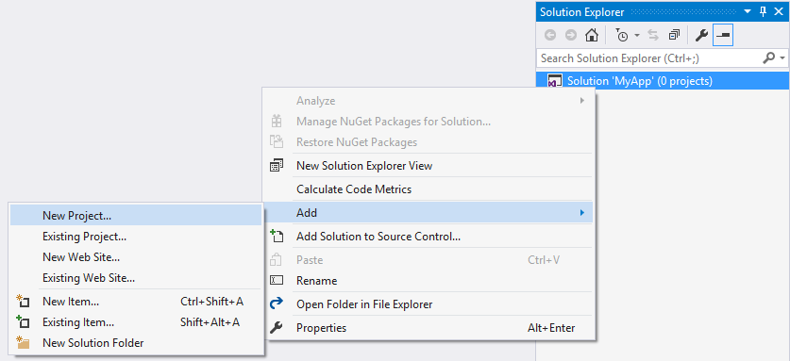
Project Organization in Visual Studio
Create separate projects for each layer of your app
From an Empty Solution, right click and select New Project

Slide 8
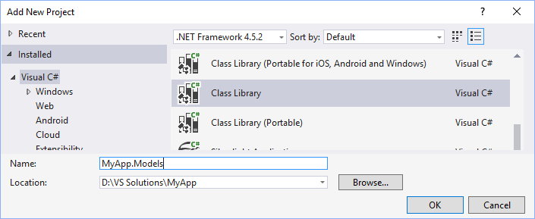
Create the Models Project
Place the domain models in a Class Library project
Affix the name of the project with .Models
Create POCO classes as usual inside the new project

Slide 9

Create the Data Layer Project
Place the data connection in a Class Library project
Affix the name of the project with .Data

Slide 10
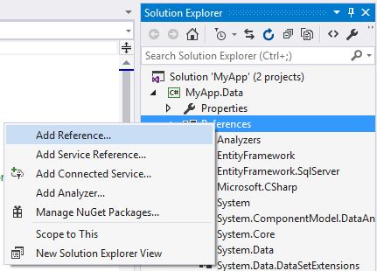
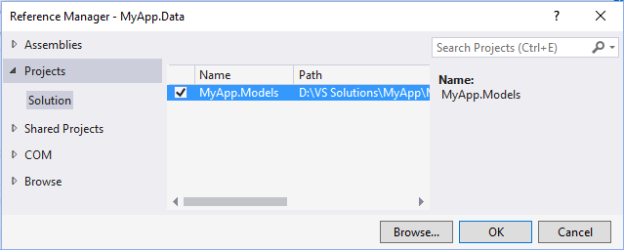
Create the Data Layer Project (2)
Add a reference to the Models project:
From the context menu under References in the Solution Explorer
Select Project ➔ Solution
Mark Models project

Slide 11
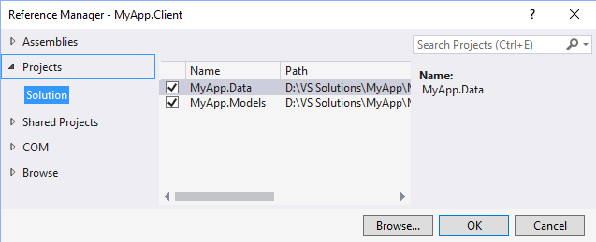
Create the Client Project
Place the client code in a project of your choice (Console, WPF, ASP.NET, etc.)
You may affix the name of the project with .Client
Add a reference to both of the Client and Data projects

Slide 12
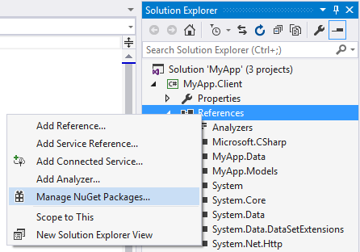
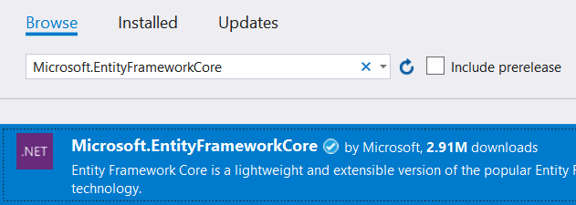
Create the Client Project (2)
Install Entity Framework Core from the NuGet Package Manager
Select Browse

Slide 13
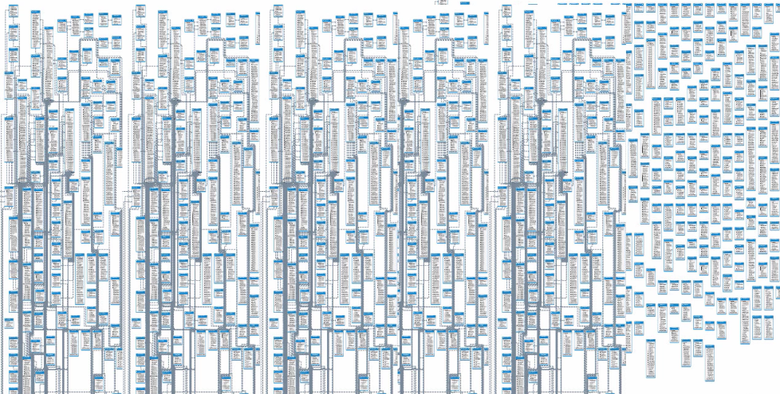
Usage Optimization
Entity Framework Performance

Slide 14
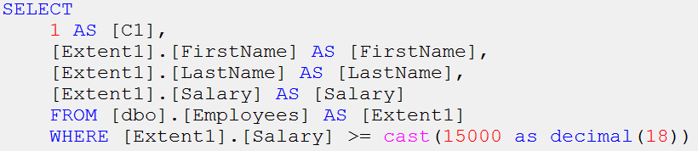
Usage Optimization
Only fetch required data by filtering and projecting your queries
context.Employees
.Where(e => e.Salary >= 15000)
.Select(e => new {
e.FirstName,
e.LastName,
e.Salary
}
);

Slide 15
Usage Optimization (2)
LINQ queries are executed each time the data is accessed
If materialized in a collection – ToList()
If the elements are aggregated – Count(), Average(), First()
When a property is accessed
Try to delay execution (materialization) until you actually need the results
Execute your query before using it in a loop!
You can monitor query execution using Express Profiler

Slide 16
Usage Optimization (3)
EF will cache entities and compare the cache for changes
Use Find() with change detection disabled
try
{
context.ChangeTracker.AutoDetectChangesEnabled = false;
var product = context.Products.Find(productId);
...
}
finally
{
context.ChangeTracker.AutoDetectChangesEnabled = true;
}

Slide 17
Usage Optimization (4)
When adding or updating a record, Entity framework makes a call to DetectChanges()
Use AddRange() and RemoveRange() to reduce calls
List<Product> products = new List<Product>()
{ product1, product2, product3 };
context.Products.AddRange(products);
Works with any collection

Slide 18
Usage Optimization (5)
Entity Framework builds associations and tracks changes for every loaded entity
If we only want to display data, this process is redundant
Disable tracking:
Note this also disables caching!
context.Products
.AsNoTracking()
.Where(p => p.Price < 150)
.ToList();

Slide 19
Loading Methods
Payload size and number of roundtrips to the database are inversely proportional
Lazy – less data, more queries
Eager – more data, less queries
There is no best approach – performance depends on usage scenario

Slide 20
Loading Methods (2)
Do you need to access many navigation properties from the fetched entities?
No – Lazy for large payloads, Eager for small
Yes – Eager loading for up three entities, Lazy for more
Do you know exactly what data will be needed at run time?
No – Lazy
Yes – Eager at first unless, Lazy if loading lots of data

Slide 21
Loading Methods (3)
Is your code executing far from your database? (increased network latency)
No – Lazy will simplify your code; don’t take database proximity for granted
Yes – Depending on scenario Eager will require fewer round trips
Always test application-wide performance, only optimize if results aren't satisfactory

Slide 22
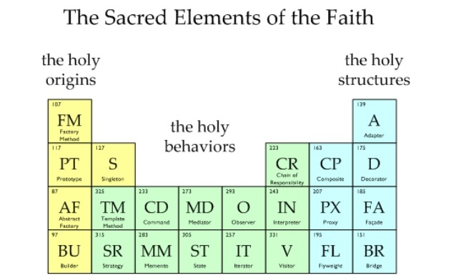
Design Patterns
Solving Problems More Easily

Slide 23
Design Patterns
Singleton – Ensure a class has only one instance and provide a global point of access to it
Service Locator – Make a service available globally and decouple the calling class from the dependent object
Command – Encapsulate a request as an object, allowing delayed execution, undo and replay

Slide 24
Singleton Pattern
public class Authenticator
{
private static Authenticator instance;
private Authenticator() { … }
public static Authenticator Instance
{
get
{
if (instance == null)
instance = new Authenticator();
return instance;
}
}
}
Private Constructor
Instantiate when first accessed

Slide 25
Service Locator
Service A
Application
Service Locator
Service B
AddService
Service C
GetService

Slide 26
Command Pattern
Dependencies
Caller
Command Parser
Command
Command
Data
Action

Slide 27
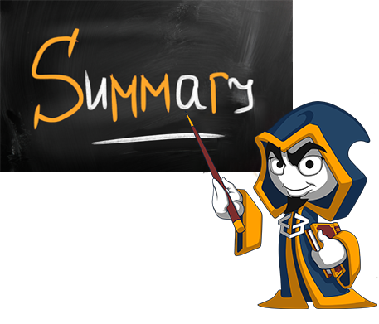
Summary
Project structure is important as an application is scaled
Entity Framework performance can be improved by following certain guidelines
Design Patterns define a common approach to solving certain development problems

Slide 28







Best Practices and Architecture
https://softuni.bg/courses/databases-basics-ms-sql-server

Slide 29






SoftUni Diamond Partners

Slide 30






SoftUni Diamond Partners

Slide 31
License
This course (slides, examples, demos, videos, homework, etc.) is licensed under the "Creative Commons Attribution-NonCommercial-ShareAlike 4.0 International" license
Attribution: this work may contain portions from
"Databases" course by Telerik Academy under CC-BY-NC-SA license

Slide 32





Trainings @ Software University (SoftUni)
Software University – High-Quality Education, Profession and Job for Software Developers
softuni.bg
Software University Foundation
http://softuni.foundation/
Software University @ Facebook
facebook.com/SoftwareUniversity
Software University Forums
forum.softuni.bg

